Slide 1
Real-Time IoT-Enabled Fall Detection System for Elderly Care Using Vital Signs, Motion Sensors, and AI-Driven Analysis
(RT-FADIS)
-An IoT-Enabled Wearable Smart Healthcare Device
Vaishnavi J (2022506068)
Deepika M (2022506069)
Aashin A P (2022506072)
An Embedded Systems and IoT-driven innovation.

Slide 2
Problem Statement
Falls are a major cause of medical emergencies for the elderly.
As people age, they become weaker and more likely to fall. Elderly individuals who live alone are at higher risk due to a lack of immediate help.
Delayed medical attention can make injuries worse and cause complications.
A real-time fall detection system is needed to ensure quick assistance and improve elderly safety.
Understanding the Issue

Slide 3
Challenges
Many fall-detection systems misclassify normal activities as falls thereby reducing the trust on the system.
NodeMCU and similar IoT devices have limited processing power and cannot run complex ML models. Processing sensor data locally on the device can cause latency issues.
It is hard to collect real fall data because falls are unpredictable and dangerous to simulate. Most datasets are small and imbalanced, leading to biased models.

Slide 4
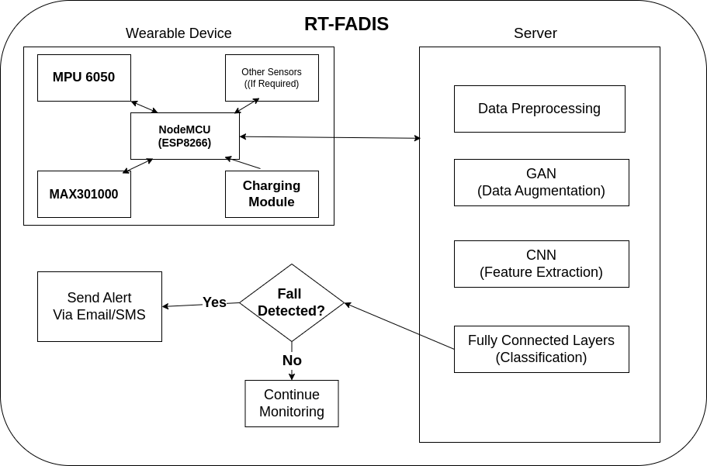
Proposed Methodology

Slide 5
Proposed Methodology (Contd.)
For the misclassification problem, our model makes use of 1D CNN and LSTM improves accuracy in distinguishing falls from daily activities. GAN-based data augmentation ensures the model generalizes well across different fall scenarios.
All these models and data processing will be done as hybrid processing:
[1]GAN-based data augmentation ensures the model generalizes well across different fall scenarios.
The Raspberry Pi (Edge AI) ensures real-time detection, while cloud processing enables scalability.

Slide 6
Proposed Methodology (Contd.)
The system can personalize fall detection thresholds based on user activity history and biometric data.
The ML models would make use of the Sisfall dataset [2] and then:
The system uses Generative Adversarial Networks (GANs)[1] to create synthetic fall data.
This increases the dataset size, making the AI model more robust.
[1] https://github.com/eriklindernoren/PyTorch-GAN
[2] https://www.kaggle.com/datasets/nvnikhil0001/sis-fall-original-dataset

Slide 7
Conclusion
This project introduces a real-time IoT-based fall detection system using wearable sensors and AI-driven analysis to enhance elderly safety.
By leveraging 1D CNN, LSTM, and GANs for data augmentation, the system improves accuracy while minimizing false alarms.
Hybrid processing with NodeMCU and Raspberry Pi/cloud ensures real-time detection and scalability.
Automated SMS, email, and IoT alerts enable quick emergency response, reducing risks.
This cost-effective and efficient solution offers a reliable alternative to commercial systems, paving the way for smarter elderly care.
Redefining Elderly Care with AI

